Slide 1


Slide 2
END TERM PRESENTATION May 2021
SettleUp: Debt Simplification & Analyzer
Minor Project-2
CSE BAO Sem-VI (Batch 2018-2022)
UNDER THE GUIDANCE OF
Mr. Rahul Kumar Singh
Assistant Professor, Department of Informatics, SOCS, UPES Dehradun
Group Details:
ROLL NO. BRANCH Avik Singla R103218190 CSE-BAO B4
Sourabh Bhandari R103218207 CSE-BAO B4
Vaishnavi Jaiswal R103218199 CSE-BAO B2 Vivek Raj R103218189 CSE-BAO B4

Slide 3

TABLE OF CONTENTS
Abstract
Introduction
Motivation
Problem Statement
Objective
Methodology
Algorithm
Flowchart & Workflow
Output Snippets
Overview
Pert Chart
References and Related Work

Slide 4



Now a days, we transact a lot on daily basis for different requirements and with different people.
Well, tracking them all might become a tedious task when you are transacting through different mediums and to different places.
This work covers to solve the task of Fair expenses and debt sharing with different parties, which covers how different intermediaries in a payment network can be simplified to make settlements easier.
The work begins by studying the concepts behind the fair division strategies and by performing tasks like sharing and splitting of rents in an optimal manner, reasonable distribution across the payment nodes and presenting user his/her spending habits.
INTRODUCTION

Slide 5

MOTIVATION
We see that whenever we go out some payments get mixed up in groups and someone is lacking behind the payments. The dues keep on piling up.
We often forget in our busy lifestyle that a particular friend owes certain amount be it small or large.
So, this program will help in solving this problem and will be useful in real life and help in managing each transaction at any point of time.
The use case can be as simple as sharing expenses with your hostel roommate to a long trip with a group of friends to Goa.

Slide 6
PROBLEM STATEMENT
Building a budget splitter application using fair division techniques.
By applying the concepts used in maximum flow algorithm on stored transaction dataset, resulting in simplified transactions with fair division method.
Completing the overall settlement in an efficient manner.
Storing and maintaining user’s data and transactions details.
Visualizing the expenses of a user in different categories.

Slide 7

OBJECTIVES
Settle all dues: Our objective is to settle all the dues or debts amongst the group of people. We will try to minimize total number of transactions to be made.
Fair Transactions: We must ensure that all the transactions are fair and completed and see that nobody ends up paying anyone less or more than their share.
Visualizing Spending Habits: We will use the past transactions to help the user learn about his/her spending habits.

Slide 8
METHODOLOGY
Simplifying debts is a feature of our application Settle Up that restructures debt within groups of people. It does not change the total amount that anyone owes, but it makes it easier to pay people back by minimizing the total number of transactions.
In our project each person will be represented in the form of a node of a directed graph and each edge of this graph will represent the amount for the transactions. We will simplify this graph to get least number of transactions.

Slide 9
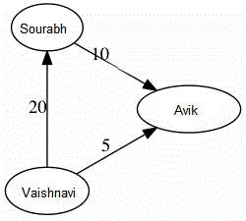
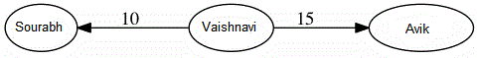
For example, let us assume 3 friends Sourabh, Avik and Vaishnavi went out for walk in a park. So, after the walk, we see that:
Vaishnavi owes Sourabh Rs.20 and Avik Rs. 5, Sourabh owes Avik Rs. 10, etc.
The goal, then, in the general case is to take a debt graph and simplify it such that:
No node has edges pointing both in and out of it.
No one owes more money in total than they did before the simplification.
Further, a user can visualize his/her expenses across different categories

Slide 10
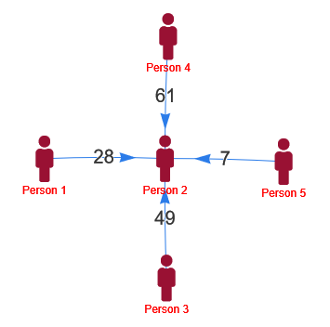
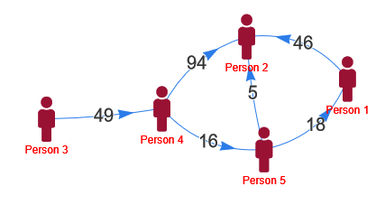
Even for a complex network of people where multiple people are involved in many transactions across the network SettleUp settles the transactions in the most optimal way possible.
The approach is greedy where at every step, all amounts of one person is settled and the program recurs for remaining (n-1) persons until the entire network is settled by constructing an equivalent graph of settled transactions.

Slide 11
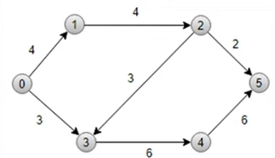
ALGORITHM
Ford Fulkerson Algorithm
Input: A graph G with source as u and sink as v Output: Residual graph and maxflow capacity of the input source & sink
max_flow=0
for each edge(u,v) in G:
flow(u,v)=w(u,v)
while there is a path p from s->t in residual graph:
min_cap = minimum residual capacity in path p.
max_flow += min_cap
for each edge(u,v) in p:
flow(u,v) = flow(u,v) - min_cap
flow(v,u) = flow(v,u) + min_cap
return max_flow
For example, here
Source = 0 , Sink = 5 Time Complexity : O(V²E)

Slide 12
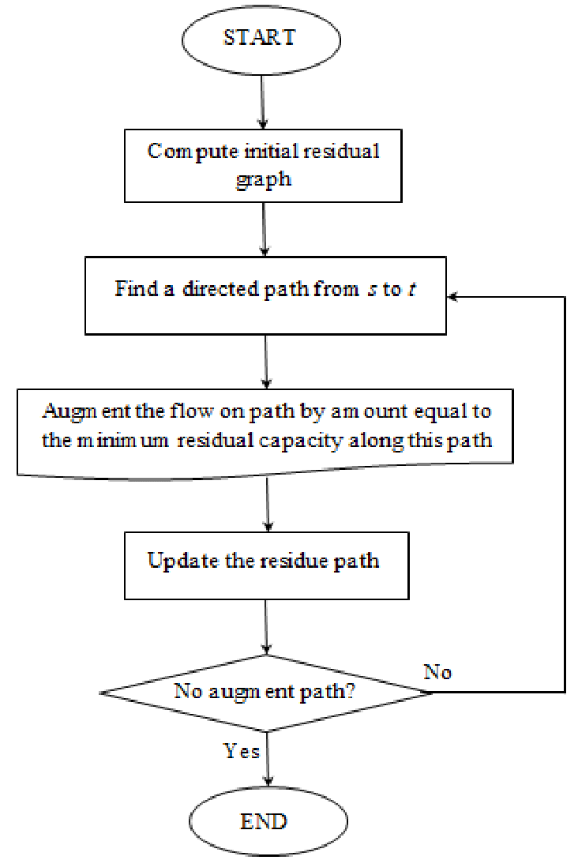
Flowchart

Slide 13
Workflow
Project Requirements:
Software Requirements: Microsoft Visual Studio, G++ Compiler, MySQL, Tableau
Hardware Requirements: A system with Windows/Linux OS.
Design: The designing of the project workflow involves thorough analysis of different use cases and flow of overall user interaction to simplify the transactions and gain overview of their expenditure with the program procedures ranging from taking input to generating the desired result.
Testing: We have tested our results through various test cases and scenarios to ensure that the program runs efficiently and produces desired results in different use cases in an optimal manner.

Slide 14
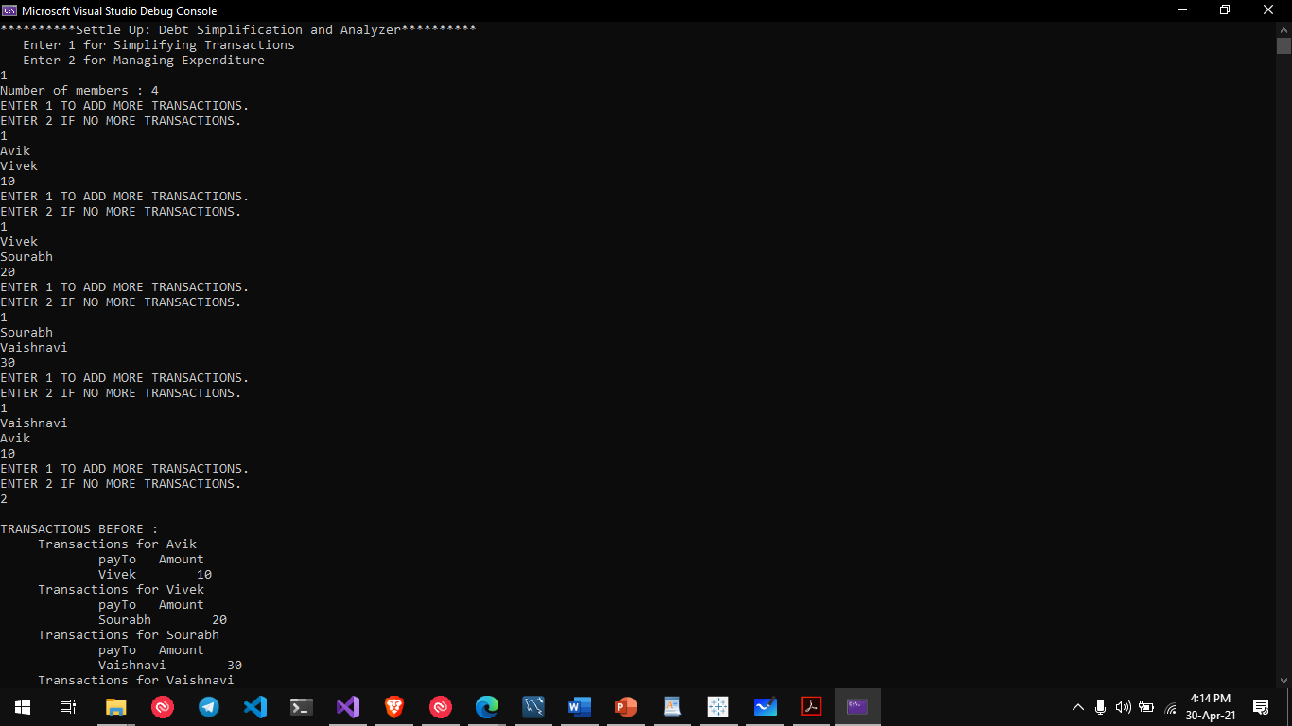
OUTPUT SNIPPETS
The Main Menu provides an option for user to seek the desired functionality of SettleUp as per need.

Slide 15
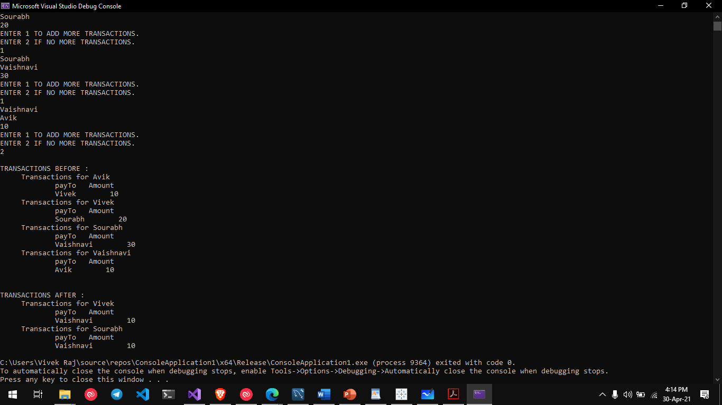
OUTPUT SNIPPETS
After simplification, we provide the optimal way for the user to complete the transactions in the network.

Slide 16
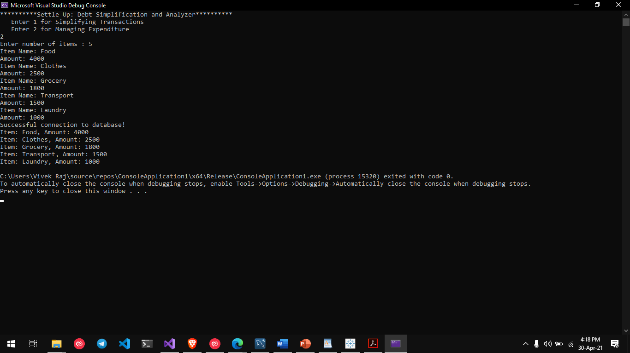
OUTPUT SNIPPETS
A user can manage and view his/her expenditure through this option of SettleUp.

Slide 17
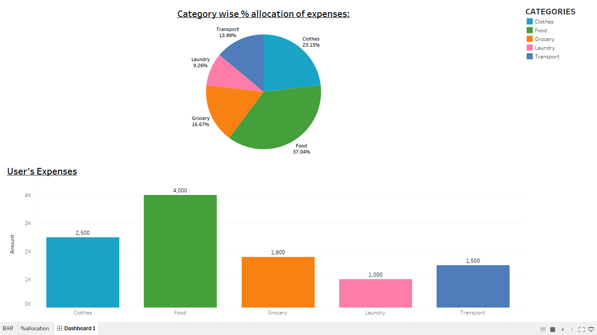
OUTPUT SNIPPETS
Further we can visualize the expenses which will be updated in real-time as the user provides new input.

Slide 18
OVERVIEW
Studying various maxflow algorithms (Dinic’s Maxflow Algorithm, Ford Fulkerson Algorithm).
Advantage of using Ford Fulkerson Algorithm over Dinic’s is that it has lesser time complexity. So, it is used to calculate the maxflow in our program.
Settling the debts among users in an optimal and unbiased manner.
Analyzing the monthly expenses of a user.

Slide 19
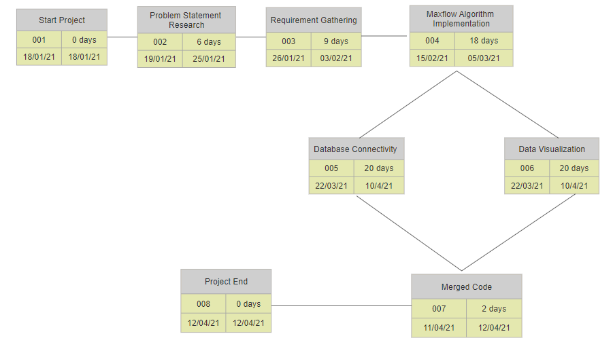
PERT CHART
STATUS OF PROJECT PROGRESS

Slide 20

References & Related Work
[1] Debt Simplification Feature | by Mithun Mohan K |, Debt Simplification Techniques, Mithun Mohan K, 2019
[2] A Fast and Simple Algorithm for the Maximum Flow Problem (researchgate.net) , James B. Orlin, Ravindra K. Ahuja, October 1989
[3] NP-Complete Splitting
[4] An Empirical Evaluation of Fair-Division Algorithms , Dupuis-Roy, Nicolas Gosselin, Frederic, 2009
[5] Ford Fulkerson's algorithm for the maximum possible flow in a network https://youtu.be/_UcOALraATY

